Slide 1
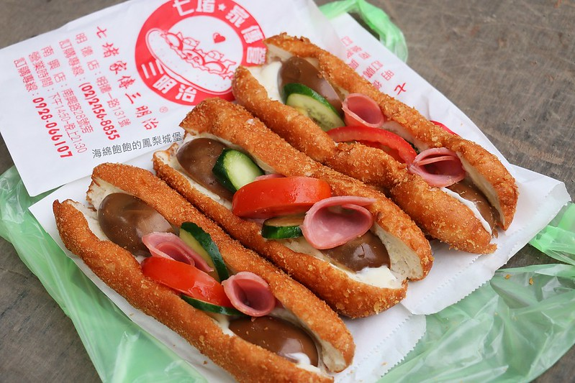





Taiwan Xiao-Chi
Differ between Northern and Southern Xiao-Chi
Northern Xiao-Chi
Southern Xiao-Chi
Shopping List
Salad Boat
Salad Boat is known as “MiaoKou Sandwich” for which MiaoKou is the name of a night market in Keelung, Taiwan. The best part of this sandwich is the bread.
The bread is crispy on the outside and soft in the inside. It has a little bit milk flavor and a little bit sweetness but not too strong with fresh cucumber, tomato, stewed eggs and ham plus Taiwanese sweet mayonnaise.
Recipe
Add flour, sugar salt, milk powder, egg into a mixing bowl and melt the yeast in the water and add them into the mixing bowl too.
Knead the step 1 for 5 to 10 minutes when it’s turn to a smooth ball and then add the butter to mix evenly.
Cover the dough with cling film and wet tea towel and leave it to arise for 1 hour - 90 minutes.
We separate the dough into a small balls weigh 50g for one after the dough arise to twice bigger than the original size.
Put a rolling pin in the middle of the small ball and flatten it towards the sides.
Use fingers to roll the flattened dough into an olive shape. Wet the dough in the cold water and then coat the dough with breadcrumb then leave it on the side for another 30~40 minutes to allow it to rise again.
Heat up the oil in a wok and deep-fry the bread roll for 3~5 minutes at a lower heat. Throw a small piece of bread into the oil if the temperature is right and the bread will flow on the oil with a lot of bubble immediately. I will cook three bread rolls at once in case the oil temperature drops too quickly.
Use a pair of scissor to cut the bread roll and put a little bit of mayonnaise first then add cucumber, tomato, ham and stewed eggs in it.
Add it to shopping list!
Taiwan Xiao-Chi
Northern Xiao-Chi
Southern Xiao-Chi
Differ Between northern and Southern Xiao-Chi
Shopping List

